Slide 1


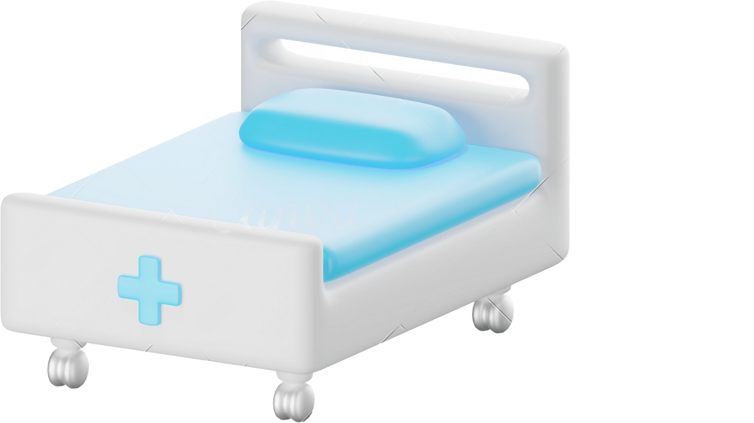
Your Health
Is Our Priority
Team Name: CodeStormers

Slide 2



Introduction
Welcome to our healthcare app, which is transforming the way you take care of yourself. Our extensive platform provides these three crucial services. Enjoy the convenience of ordering medications online to save time and effort. Second, our trustworthy reminder service guarantees that you never miss a dosage, encouraging adherence to your prescribed medication schedule. Finally, receive useful information about your prescription drugs while easily managing and tracking your medication stock. Utilise our cutting-edge app, created with your wellbeing in mind, to take control of your health journey.

Slide 3

Features
Online Medicine Booking
Reminder Service
Medication Stock Management

Slide 4
Features
User-Friendly Interface
Personalization
Secure and Private

Slide 5
User Interface
Book Medicine
Paracetamol
Dettol
.............
.............
Buy
Home
REGISTER LOGIN
Never Miss a Dose
Create Reminder
Candidate Name
Party Name
Symbol
Submit
Home
LOGOUT
Optimize Medication Stock
Medicine Data
Medicine Name
Number of pills
.............
Submit

Slide 6
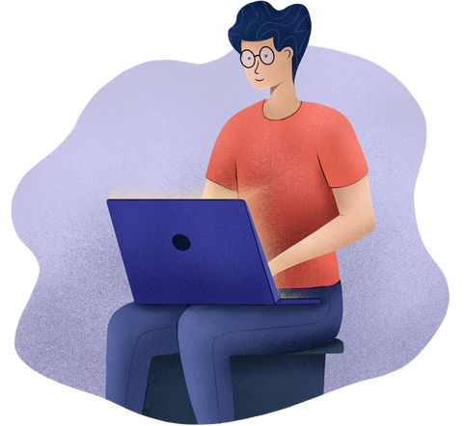







Technology
Front end :
html5, css3, JavaScript, bootstrap
Back end :
Nodejs, Expressjs
Database :
MongoDB

Slide 7
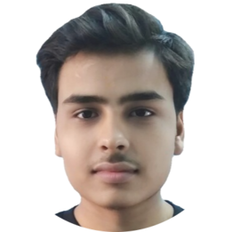
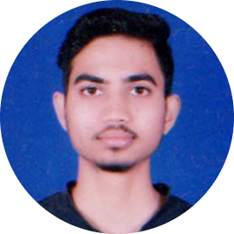

Team Member
CODE STORMERS
Gaurav Pathak
Chintu Raj Gupta
Chintu Raj Gupta
Chintu Raj Gupta
Web Developer
Web Developer
Chintu Raj Gupta
Chintu Raj Gupta
Web Developer
Web Developer
Web Developer
Web Developer

Slide 8

Conclusion
In conclusion, our healthcare application plays a major role in the world of medical management. We have streamlined and simplified the way you receive healthcare services with online medicine booking, a reminder service, and medication stock management. With our customised reminders, you'll never miss a dosage again, and you'll love how easy it is to track and manage your medicine stock. With the help of our modern applications, empower yourself with useful information and take charge of your health path. Experience the future of healthcare today!

Slide 9


STUDIO SHODWE
Contact Us
gauravpathak182@gmail.com
@gmail.com
Greater Noida, U.P. India

Slide 10

Your Health Is Your No.1 Priority
Thank You

